Slide 1
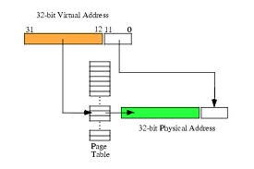
CS 345 Project 4
Virtual Memory Project

Slide 2
Learning Objectives…
Student explores the concepts of swap space, main memory, and virtual memory.
Understand the details of page faulting and page replacement algorithms, what memory access, hit and fault counts are, and how to track them.
Student implements a virtual address translation system (MMU) to Project 4 using a two-level hierarchical page table system.
An LC-3 processor is provided that makes all memory accesses through one function.
That’s right! You only need to implement one function for Project 4, namely, getMemAdr().

Slide 3
Virtual Memory
Virtual
Address
f (va)
Physical
Address
LC-3
MMU
LC-3
Memory
2¹⁶ Words
getMemAdr()
(Hardware)
→PC-Relative
→Indirect
→Base+Offset
IR, TRAP
LD, LDR, LDI
ST, STR, STI
OS Clock
Replacement Algorithm
Paged
Swap Space

Slide 4
Project 4 – Virtual Memory
unsigned short int *getMemAdr(int va, int rwFlg)
{
unsigned short int pa;
// turn off virtual addressing for system RAM
if (va < 0x3000) return &memory[va];
// calculate physical from virtual address
pa = va;
// return physical memory address
return &memory[pa];
} // end getMemAdr
Notes:
4

Slide 5
Crawler, Memtest
Welcome to OS345 Rev 1.1
0>>crawler
178068>>
Crawler R1.1
Process 1: Move #1 to xE29E
Process 1: Move #2 to x6B3F
…
Process 1: Move #99 to x932E
Process 1: Move #100 to xDA8F
Process #1 Halted at 0x937e
1807827>>memtest
MemTest R1.0a
(1) Round 1, Writing to memory...
(1) Round 1, Verifying...
(1) Round 2, Writing to memory...lt
# TID name address line prior time semaphore status
0 0/0 CLI 403b61 457 5 1 Running
1 1/0 LC3 MemTest 40190c 0 5 1 Waiting
1911162>>
(1) Round 2, Verifying...
(1) Round 3, Writing to memory...
(1) Round 3, Verifying...
…
(1) Round 10, Writing to memory...
(1) Round 10, Verifying...
Process #1 Halted at 0x305c
Notes:
5

Slide 6
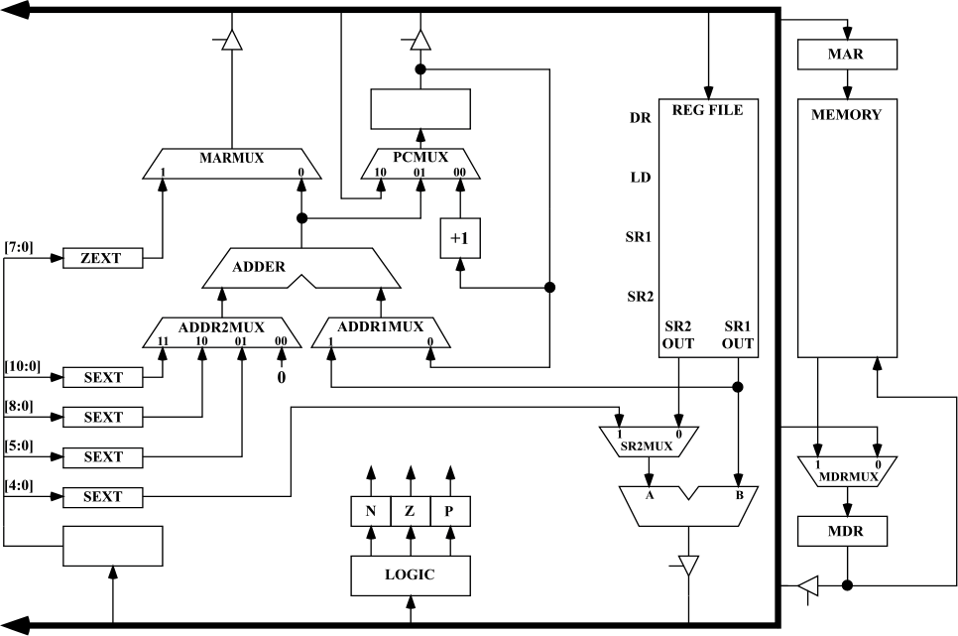
LC-3 Simulator
Project 4
MAR access thru getMemAdr(va, rwflg)
MDR access thru getMemData(va)
setMemData(va)
Notes:
6

Slide 7
Two-Level Paging System
Virtual Address
15 … 11 10 … 6 5 … 0
RPTE #
UPTE #
Frame Offset
Root Page Table
User Page Table
LC-3 Main Memory
+
Flags / Frame #
Flags / UPT #
+
Frame<<6
Offset
15 … 6 5 … 0
tcb[curTask].RPT
One per process
Physical Address

Slide 8
Virtual Memory
x0000
System (unmapped)
Virtual Address
x2000
Frame Table
All tables in LC-3 memory.
All memory accesses thru getMemAdr().
RPT’s pinned.
Each process has an RPT pointer (swapped on context switch).
x2400
RPT’s (Pinned)
x3000
UPT’s
(Swappable Frames)
User Frames
Paged
Swap
Space
Memory Limit
(Variable)
xFFFF
Notes:
8

Slide 9
#defines…
2¹⁶ Words
#define LC3_MAX_MEMORY 65536
#define LC3_FRAME_SIZE 64
#define LC3_FRAMES 1024
#define LC3_FBT 0x2000
#define LC3_RPT 0x2400
#define LC3_RPT_END 0x2800
#define LC3_MEM 0x3000
#define LC3_MEM_END 0x10000
#define LC3_MAX_PAGE (LC3_FRAMES<<2)
#define LC3_MAX_SWAP_MEMORY (LC3_MAX_PAGE<<6)
#define LC3_FBT_FRAME (LC3_FBT>>6)
#define LC3_RPT_FRAME (LC3_RPT>>6)
#define LC3_RPT_END_FRAME (LC3_RPT_END>>6)
#define LC3_MEM_FRAME (LC3_MEM>>6)
#define LC3_MEM_END_FRAME (LC3_MEM_END>>6)
// parts of a virtual address
#define RPTI(va) (((va)&BITS_15_11_MASK)>>10)
#define UPTI(va) (((va)&BITS_10_6_MASK)>>5)
#define FRAMEOFFSET(va) ((va)&BITS_5_0_MASK)
2⁶ Words
2¹⁶ / 2⁶ = 2¹⁰ Frames
Frame Bit Table
Root Page Tables
Start User Memory
Root Page Table Index
User Page Table Index

Slide 10
#defines…
// definitions within a root or user table page
#define DEFINED(e1) ((e1)&BIT_15_MASK)
#define DIRTY(e1) ((e1)&BIT_14_MASK)
#define REFERENCED(e1) ((e1)&BIT_13_MASK)
#define PINNED(e1) ((e1)&BIT_12_MASK)
#define FRAME(e1) ((e1)&BITS_9_0_MASK)
#define PAGED(e2) ((e2)&BIT_15_MASK)
#define SWAPPAGE(e2) ((e2)&BITS_12_0_MASK)
#define MEMWORD(a) (memory[a])
#define MEMLWORD(a) ((memory[a]<<16)+memory[(a)+1])
#define SET_DEFINED(e1) ((e1)|BIT_15_MASK)
#define SET_DIRTY(e1) ((e1)|BIT_14_MASK)
#define SET_REF(e1) ((e1)|BIT_13_MASK)
#define SET_PINNED(e1) ((e1)|BIT_12_MASK)
#define SET_PAGED(e2) ((e2)|BIT_15_MASK)
#define CLEAR_DEFINED(e1) ((e1)&~BIT_15_MASK)
#define CLEAR_DIRTY(e1) ((e1)&~BIT_14_MASK)
#define CLEAR_REF(e1) ((e1)&~BIT_13_MASK)
#define CLEAR_PINNED(e1) ((e1)&~BIT_12_MASK)

Slide 11
Page Table Entry
4 bytes
 |  |  |  |  |  | Frame # (0 – 1023)
F | D | R | P | - | - | f | f | f | f | f | f | f | f | f | f
 |  |  |  | Page # (0 – 8191)
S | - | - | p | p | p | p | p | p | p | p | p | p | p | p | p
• Frame valid (1 bit): one if referenced frame is in main memory; zero otherwise.
• Dirty (1 bit): one if referenced frame has been altered; zero otherwise.
• Reference (1 bit): one if frame has been referenced; zero otherwise.
• Pinned (1 bit): one if frame is pinned in memory; zero otherwise.
• Frame number (10 bits): If referenced page is in memory, this value specifies which frame it occupies. (1024 frames × 64 words = 2¹⁰ × 2⁶ = 2¹⁶ bytes = 65536 words.)
• Swap valid (1 bit): one if referenced page has been allocated in swap space; zero otherwise.
• Swap page number (13 bits). This specifies where referenced page is stored in swap space. When you load a page into memory, you should include this value in your frame table summary. (8,192 pages × 128 bytes = 2¹³ × 2⁷ = 2²⁰ bytes = 1,048,576 bytes.)
Notes:
11

Slide 12
Virtual to Physical Address
memory[taskRPT + ((((va)&0xf800)>>11)<<1)]
memory[(rpte1&0x03ff)<<6+((((va)&0x7c0)>>6)<<1)]
&memory[(upte1&0x03ff)<<6+((va)&0x003f)]
rpte1 = MEMWORD(taskRPT + RPTI(va));
upte1 = MEMWORD((FRAME(rpte1)<<6) + UPTI(va));
&memory[(FRAME(upte1)<<6) + FRAMEOFFSET(va)];

Slide 13
Global Clock
Swap Space
RPTE’s
UPTE’s
Frame’s
Notes:
13

Slide 14
8 Frame Exercise

Slide 15
unsigned short int *getMemAdr(int va, int rwFlg) { if (va < 0x3000) return &memory[va]; // turn off virtual addressing for system RAM rpta = tcb[curTask].RPT + RPTI(va); rpte1 = MEMWORD(rpta); rpte2 = MEMWORD(rpta+1); if (DEFINED(rpte1)) { // rpte defined } else // rpte undefined 1. get a UPT frame from memory (may have to free up frame) { // 2. if paged out (DEFINED) load swapped page into UPT frame // else initialize UPT frame = getFrame(-1); rpte1 = SET_DEFINED(frame); if (PAGED(rpte2)) // UPT frame paged out - read from SWAPPAGE(rpte2) into frame { accessPage(SWAPPAGE(rpte2), frame, PAGE_READ); } else // define new upt frame and reference from rpt { rpte1 = SET_DIRTY(rpte1); rpte2 = 0; // undefine all upte's } } MEMWORD(rpta) = rpte1 = SET_REF(SET_PINNED(rpte1)); // set rpt frame access bit MEMWORD(rpta+1) = rpte2; upta = (FRAME(rpte1)<<6) + UPTI(va); upte1 = MEMWORD(upta); upte2 = MEMWORD(upta+1); if (DEFINED(upte1)) { // upte defined } else // upte undefined 1. get a physical frame (may have to free up frame) (x3000 - limit) (192 - 1023) { // 2. if paged out (DEFINED) load swapped page into physical frame // else new frame } return &memory[(FRAME(upte1)<<6) + FRAMEOFFSET(va)]; // return physical address} }
unsigned short int *getMemAdr(int va, int rwFlg)
MMU turned off for system access
Hit!
Page Fault
Go get a Frame
UPT Page in swap space
Frame referenced
New UPT Frame
Hit!
Page Fault
Notes:
15

Slide 16
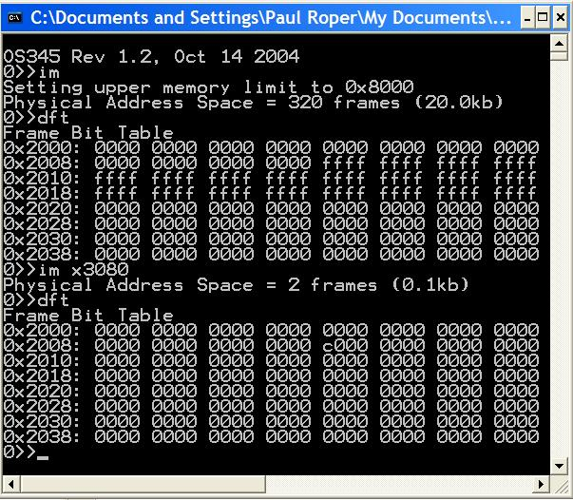
Frame Bit Table
0x3000
0x8000
2 Frames

Slide 17
accessPage
// ********************************************************************************************
// read/write to swap space
int accessPage(int pnum, int frame, int rwnFlg)
{ static unsigned short int swapMemory[LC3_MAX_SWAP_MEMORY];
switch(rwnFlg)
{ case PAGE_GET_ADR: // return page address
{ return (int)(&swapMemory[pnum<<6]);
}
case PAGE_NEW_WRITE: // new write
{ pnum = nextPage++;
}
case PAGE_OLD_WRITE: // write
{ memcpy(&swapMemory[pnum<<6], &memory[frame<<6], 1<<7);
return pnum;
}
case PAGE_READ: // read
{ memcpy(&memory[frame<<6], &swapMemory[pnum<<6], 1<<7);
return pnum;
}
}
return pnum;
}

Slide 18
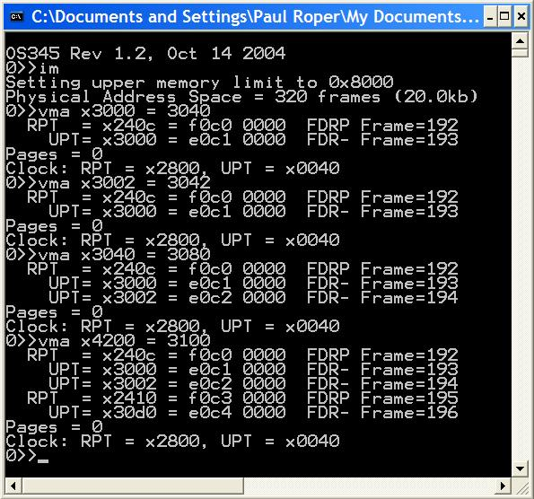
vma
2 frames – UPT, Frame
No new frames
Same UPT, new Frame
No swap pages
New UPT, new Frame
Clock did not advance

Slide 19
Virtual Memory Guidelines
Verify a clean compilation of your LC-3 virtual memory simulator. Validate that “crawler.hex” and “memtest.hex” programs execute properly.
Modify the getMemAdr() function to handle a 2-level, paging, virtual memory addressing.
Implement a clock page replacement algorithm to pick which frame is unloaded, if necessary, on a page fault.
Use the provided 1MB page swap table routine to simulate paged disk storage (8192 pages) or implement your own routine.
Use crawler.hex and memtest.hex to validate your virtual memory implementation. Use other routines (such as im) to debug you implementation.

Slide 20
Virtual Memory Guidelines
Use the following CLI commands to verify and validate your virtual memory system. (Most of these routines are provided, but may require some adaptation to your system.)
dfm <#> Display LC3 memory frame <#>
dft Display frame allocation table
dm <sa>,<ea> Display physical LC3 memory from <sa> to <ea>
dp <#> Display page <#> in swap space
dv <sa>,<ea> Display virtual LC3 memory <sa> to <ea>
im <ea> Init LC3/Set upper LC3 memory limit
rpt <#> Display task <#> root page table
upt <p><#> Display task <p> user page table <#>
vma <a> Access <a> and display RPTE’s and UPTE’s
vms Display LC3 statistics

Slide 21
Virtual Memory Guidelines
Demonstrate that LC-3 tasks run correctly. Be able to dynamically change LC-3 memory size (im command) and chart resulting changes in page hits/faults. Memory accesses, hits and faults are defined as follows:
Memory access (memAccess) = sum of memory hits (memHits) and memory faults (memPageFaults).
Hit (memHits) = access to task RPT, UPT, or data frame. (Exclude accesses below 0x3000.)
Fault (memPageFaults) = access to a task page that is undefined or not currently in a memory frame.
Page Reads (pageReads) = # pages read from swap space into memory.
Page Writes (pageWrites) = # pages written from memory to swap space.
Swap Page (nextPage) = # of swap space pages currently allocated to swapped pages.
 | Crawler |  |  | Memtest
Frames: | 320 | 16 | 2 | 320 | 16 | 2
Accesses:
Hits:
Faults:
Page Reads:
Page Writes:
Swap Pages:

Slide 22
Project 4 Grading Criteria
REQUIRED:
4 pts – Successfully execute crawler and memtest in 20k words (320 frames).
3 pts – Successfully execute crawler and memtest in 1k words (16 frames).
1 pt – Successfully execute 5 or more LC-3 tasks simultaneously in 16 frames of LC-3
memory.
1 pt – Correctly use the dirty bit to only write altered or new memory frames to swap
space.
1 pt – Chart and submit the resulting memory access, hit, fault, and swap page statistics
after executing crawler (and then memtest) in 320 and 16 frames (vms).
BONUS:
+1 point – early pass-off (at least one day before due date.)
+1 point – Add a per/task frame/swap page recovery mechanism of a terminated task.
+1 point – Implement the advanced clock algorithm and chart the results.
+1 point – Join the 2-frame club. (Successfully execute 5 or more LC-3 tasks
simultaneously in 2 frames of LC-3 memory. Chart the memory accesses,
hits, and faults.)
–1 point penalty for each school day late.

Slide 23
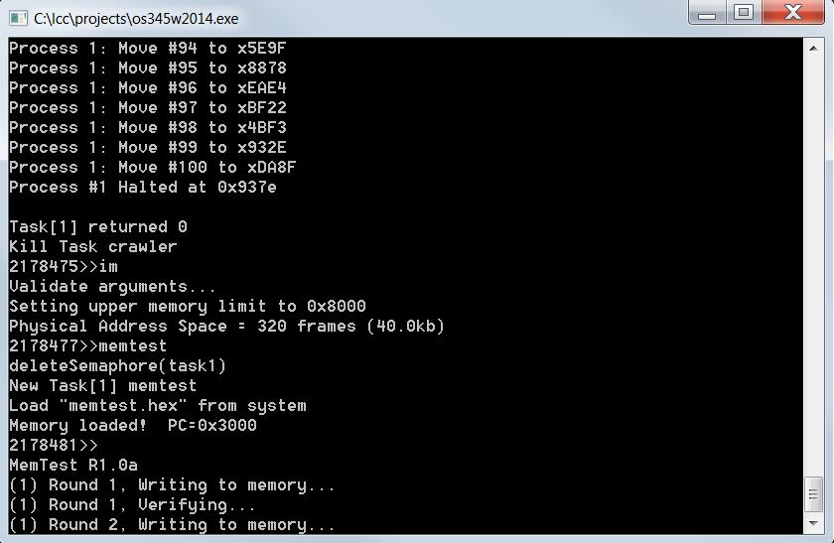
Step 1 – Virtual Memory
1. Validate that the demo LC-3 simulator works for a single task with pass-through addressing (virtual equals physical) for the LC-3 by setting MMU_ENABLE to 0 and executing the commands “crawler” and “memtest”.
#define MMU_ENABLE 0
unsigned short int *getMemAdr(int va, int rwFlg)
{
unsigned short int pa;
// turn off virtual addressing for system RAM
if (va < 0x3000) return &memory[va];
#if MMU_ENABLE
#else
// calculate physical from virtual virtual
pa = va;
#endif
// return physical memory address
return &memory[pa];
} // end getMemAdr

Slide 24
Step 2 – Virtual Memory
2. Implement page fault frame replacement using available memory frames only.
Modify createTask() to allocate an unique Root Page Table for each task. (ie, tcb[tid].RPT = LC3_RPT + ((tid) ? ((tid-1)<<6) : 0);)
Fix getMemAdr such that if root page table entry undefined, use getFrame to return a new UPT frame from available memory and initialize all user page table entries.
Fix getMemAdr such that if user page table entry undefined, use getFrame to return a new data frame from available memory.
This should allow you to execute any test program in a full address space.

Slide 25
Step 3 – Virtual Memory
Implement clock page replacement algorithm to unload data frames to swap pages and reload with a new frame or an existing frame from swap space if needed.
Create and validate a “clock” mechanism that accesses all global root page tables, user page tables, and data frames.
Swap to swap space the first frame with the reference bit equal to zero (and not equal to the notme frame).
Advance the clock.
Return frame number for use as a UPT or data frame.
Use the vma function to access a single virtual memory location and then display any non-zero RPT and UPT entries.
This should allow you to execute all the test programs in a 32k word address space (20k of paging frames).

Slide 26
Step 4 – Virtual Memory
Implement clock page replacement algorithm to unload User Page Tables when there are no physical data frame references in the UPT. This will be necessary when running in a small physical space (16k words) with multiple tasks.
If a User Page Table does not have the reference bit set AND does not have any entries with in-memory frame bit set AND if not the notme frame, swap to swap space.
Advance the clock.
Return frame number for use as a UPT or data frame.
When swapping a user page table to swap space, add some debug “sanity check” code to validate that the UPT does not have any entries with the frame bit set.
Use the vma function to access a single virtual memory location and then display any non-zero RPT and UPT entries.
5. Implement dirty bit to minimize writing frames to swap space.

Slide 27

Notes:
Paul Roper
27

